Slide 1
Kubernetes: Under the Hood (Oct 19, 2019)

Slide 2
OUTLINE
Deploying an application on K8s
Under the hood from the following perspectives:
User
Cluster
Networking
Cloud
OS (Linux)

Slide 3
OUTLINE
Deploying an application on K8s
Under the hood from the following perspectives:
User
Cluster
Networking
Cloud
OS (Linux)

Slide 4
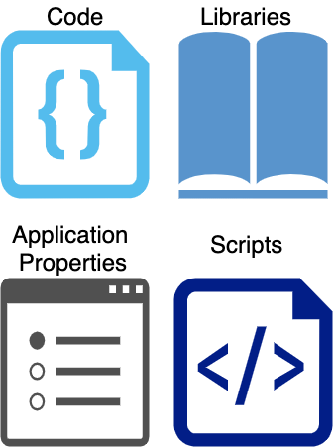
What is a container?

Slide 5
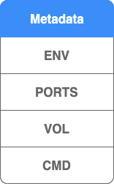
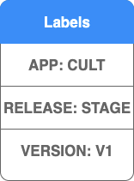
What is a container?
container

Slide 6



What is a container?
container
fluentd
envoy

Slide 7
Pod
Pod
container
fluentd
envoy

Slide 8
Pod
Pod
Cult-api-a-v1
Port
3000
Pod
Cult-api-b-v1
Port
3000

Slide 9
Deployment
Deployment
selector
api: cult release: stage
image
curefit/cult-api:v1
Pod
Cult-api-a-v1
Service
Port
3000
Cult-api
selector
api: cult release: stage
Pod
port
80:3000
Cult-api-b-v1
ip
10.0.172.34
Port
3000

Slide 10
Deployment
selector
api: cult release: stage
image
curefit/cult-api:v1
Pod
Cult-api-a-v1
Service
Port
3000
Cult-api
selector
api: cult release: stage
Pod
port
80:3000
Cult-api-b-v1
ip
10.0.172.34
Port
3000

Slide 11
Ingress
Deployment
Cult-api
selector
api: cult release: stage
host
cultapi.stage.com
image
curefit/cult-api:v1
Pod
Cult-api-a-v1
Service
Port
3000
Cult-api
selector
api: cult release: stage
Pod
port
80:3000
Cult-api-b-v1
ip
10.0.172.34
Port
3000

Slide 12
Kubectl

Slide 13
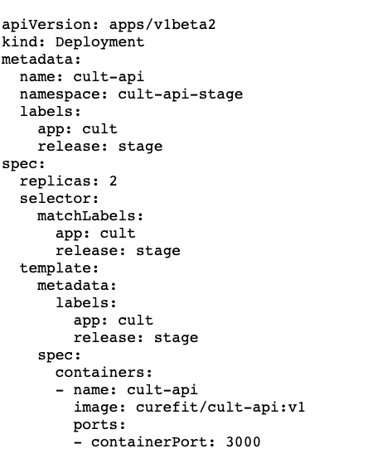

Slide 14
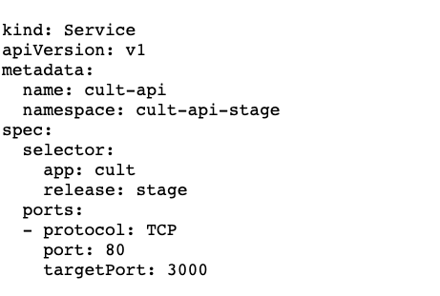

Slide 15
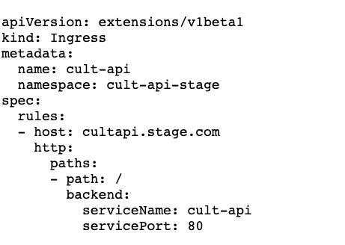

Slide 16
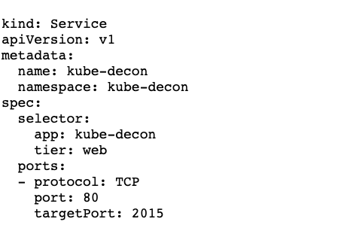
API Server

Slide 17
API Server
Deployment
Service
Ingress
Cult-api
Cult-api
Cult-api
Pod
Pod
Cult-api-a-v1
Cult-api-b-v1

Slide 18
OUTLINE
Deploying an application on K8s
Under the hood from the following perspectives:
User
Cluster
Networking
Cloud
OS (Linux)

Slide 19
Kubernetes Components
Master Components
Kube-api server
Kube-scheduler
Kube-controller-manager
Worker Components
Kubelet
kube-proxy

Slide 20
Kubernetes Components
Master Components
Kube-api server
Kube-scheduler
Kube-controller-manager
Worker Components
Kubelet
kube-proxy

Slide 21
Kube API Server
Deployment
Service
Ingress
Cult-api
Cult-api
Cult-api
Pod
Pod
Cult-api-a-v1
Cult-api-b-v1

Slide 22

Kube-api server
Kube API Server
etcd
etcd
etcd

Slide 23
Kubernetes Components
Master Components
Kube-api server
Kube-scheduler
Kube-controller-manager
Worker Components
Kubelet
kube-proxy

Slide 24
Kubernetes Components
Master Components
Kube-api server
Kube-scheduler
Kube-controller-manager
Worker Components
Kubelet
kube-proxy

Slide 25
watch
Kube API Server
Kube Scheduler
Pod
Pod
Node
Node
Node
Pod
Pod

Slide 26
Kube-scheduler
Affinity/Anti-affinity
nodeSelector
taints/tolerations
reservations/limits

Slide 27
Affinity
Pod
Pod
Node
Node

Slide 28
Affinity
Pod
Pod
Node
Node
Pod
Pod

Slide 29
Anti-affinity
Pod
Pod
Node
Node

Slide 30
Anti-affinity
Pod
Pod
Node
Node
Pod
Pod

Slide 31
Node Selector
Node
Pod
nodeselector
spot=true
Pod
nodeselector
spot=true
label
spot=true

Slide 32
Taint-Toleration
Node
Pod
toleration
spot=true:NoSchedule
Pod
Pod
toleration
spot=true:NoSchedule
taint
spot=true:NoSchedule

Slide 33
Reservations-Limits
Node
Pod
cpu
1 core
Pod
memory
2GB
cpu
1 core
memory
2GB
Pod
cpu
4 core
cpu
2 cores
memory
8 GB
memory
4GB

Slide 34
Kubernetes Components
Master Components
Kube-api server
Kube-scheduler
Kube-controller-manager
Worker Components
Kubelet
kube-proxy

Slide 35
Kubernetes Components
Master Components
Kube-api server
Kube-scheduler
Kube-controller-manager
Worker Components
Kubelet
kube-proxy

Slide 36
Kube Controller Manager
Node Controller: Responsible for noticing and responding when nodes go down
Replication Controller: Responsible for maintaining the correct number of pods for every replication controller object in the system
Endpoints Controller: Populates the Endpoints object (that is, joins Services & Pods)
Service Account & Token Controllers: Create default accounts and API access tokens for new namespaces

Slide 37
Kube Controller Manager
Kube API Server
Kube controller manager
namespace
Node controller
deployments
Deployment controller
replicasets
watch
Replicaset controller
pods
Endpoint controller
services
Service account controller
ingress

Slide 38
Kube Controller Manager
Namespace
Deployment
Service
Ingress
Cult-api
Cult-api
Cult-api
Replica-set
Endpoint
Service Account
Cult-api
Cult-api
Cult-api
Pod
Cult-api-a-v1

Slide 39
Kubernetes Components
Master Components
Kube-api server
Kube-scheduler
Kube-controller-manager
Worker Components
Kubelet
kube-proxy

Slide 40
Kubernetes Components
Master Components
Kube-api server
Kube-scheduler
Kube-controller-manager
Worker Components
Kubelet
kube-proxy

Slide 41
watch
Kube API Server
kubelet
docker/rkt
Node
healthcheck
Pod
Cult-api-a-v1
readiness probe

Slide 42
Kubernetes Components
Master Components
Kube-api server
Kube-scheduler
Kube-controller-manager
Worker Components
Kubelet
kube-proxy

Slide 43
Kubernetes Components
Master Components
Kube-api server
Kube-scheduler
Kube-controller-manager
Worker Components
Kubelet
kube-proxy

Slide 44
watch
Kube API Server
kube-proxy
Service
Cult-api
Node
Node
Node
Pod
Pod
Cult-api-a-v1
Cult-api-b-v1

Slide 45
watch
Kube API Server
kube-proxy
Service
Cult-api
Node
Node
Node
Pod
Pod
Pod
Cult-api-a-v1
Cult-api-a-v1
Cult-api-b-v1

Slide 46
OUTLINE
Deploying an application on K8s
Under the hood from the following perspectives:
User
Cluster
Networking
Pods
Services
Cloud
OS (Linux)

Slide 47
OUTLINE
Deploying an application on K8s
Under the hood from the following perspectives:
User
Cluster
Networking
Pods
Services
Cloud
OS (Linux)

Slide 48
Ingress
Deployment
Cult-api
selector
api: cult release: stage
host
cultapi.stage.com
image
curefit/cult-api:v1
Pod
Cult-api-a-v1
Service
Port
3000
Cult-api
selector
api: cult release: stage
Pod
port
80:3000
Cult-api-b-v1
ip
10.0.172.34
Port
3000

Slide 49
Ingress
Deployment
Cult-api
selector
api: cult release: stage
host
cultapi.stage.com
image
curefit/cult-api:v1
Pod
Cult-api-a-v1
Service
Port
3000
Cult-api
selector
api: cult release: stage
Pod
port
80:3000
Cult-api-b-v1
ip
10.0.172.34
Port
3000

Slide 50
Pod
Cult-api-a-v1
Port
3000
ip
10.255.0.10

Slide 51
Node
Pod
Cult-api-a-v1
Port
3000
ip
10.255.0.10
ip
10.0.1.4
Pod cidr
10.255.0.0/24

Slide 52
Node
Node
Pod
Network Provider
Pod
Cult-api-a-v1
Cult-api-b-v1
Port
3000
Port
3000
ip
10.255.0.10
ip
10.255.0.11
ip
10.0.1.4
ip
10.0.1.5
Pod cidr
10.255.0.0/24
Pod cidr
10.255.0.0/24

Slide 53
Network Provider
“All containers must be able to talk to all other containers without NAT”

Slide 54
Pod
Pod
Cult-api-a-v1
Cult-api-b-v1
Port
3000
Port
3000
ip
10.255.0.10
ip
10.255.0.11
Pod
Pod
Cult-api-d-v1
Cult-api-c-v1
Port
3000
Port
3000
ip
10.255.0.13
ip
10.255.0.12

Slide 55
Network Provider
“All containers must be able to talk to all other containers without NAT”
“All nodes can communicate with all containers (and vice versa) without NAT”

Slide 56
Node
Pod
Cult-api-a-v1
Port
3000
ip
10.255.0.10
ip
10.0.1.4
Pod cidr
10.255.0.0/24
Node
Pod
Cult-api-b-v1
Port
3000
ip
10.255.0.11
ip
10.0.1.4
Pod cidr
10.255.0.0/24

Slide 57
Network Provider
“All containers must be able to talk to all other containers without NAT”
“All nodes can communicate with all containers (and vice versa) without NAT”
“The IP that the container sees itself as is the same IP that others see it as”

Slide 58
OUTLINE
Deploying an application on K8s
Under the hood from the following perspectives:
User
Cluster
Networking
Pods
Services
Cloud
OS (Linux)

Slide 59
Ingress
Deployment
Cult-api
selector
api: cult release: stage
host
cultapi.stage.com
image
curefit/cult-api:v1
Pod
Cult-api-a-v1
Service
Port
3000
Cult-api
selector
api: cult release: stage
Pod
port
80:3000
Cult-api-b-v1
ip
10.0.172.34
Port
3000

Slide 60
Service
Cult-api
selector
api: cult release: stage
ip
10.0.172.34
port
80:3000
port
81:3001
port
82:3000

Slide 61
Service
Load Balancer
Cult-api
selector
api: cult release: stage
NodePort
ip
10.0.172.34
port
80:3000
ClusterIP
type

Slide 62
Service
Load Balancer
Cult-api
selector
api: cult release: stage
NodePort
ip
10.0.172.34
port
80:3000
ClusterIP
type
ClusterIp
clusterIP
10.0.171.239

Slide 63
Pod
frontend
Port
3000
Service
Pod
backend
backend
ip
10.0.172.34
Port
3000
Pod
frontend
Port
3000

Slide 64
10.0.172.34
backend
backend.cult-stage
backend.cult-stage.svc.cluster.local

Slide 65
Pod
Pod
frontend
backend
Port
3000
Port
3000
Service
Pod
backend
backend
ip
10.0.172.34
Port
3000
Pod
Pod
frontend
backend
Port
3000
Port
3000

Slide 66
10.0.172.34
Node
Node
Pod
Pod
frontend
backend
Port
3000
Port
3000
ip
10.255.0.10
ip
10.255.0.11
ip
10.0.1.4
ip
10.0.1.5
Pod cidr
10.255.0.0/24
Pod cidr
10.255.0.0/24

Slide 67
Node
services
Kube Proxy
endpoints
Pod
frontend
Pod
Port
3000
backend
ip
10.255.0.12
Port
3000
ip
10.255.0.10
iptables
10.0.172.34
Pod
ip
10.0.1.4
backend
Port
3000
Pod cidr
10.255.0.0/24
ip
10.255.0.11

Slide 68
Service
Load Balancer
Cult-api
selector
api: cult release: stage
NodePort
ip
10.0.172.34
port
80:3000
ClusterIP
type
Nodeport

Slide 69
Node
31222
iptables
Pod
Service
Cult-api-a-v1
Port
3000
Cult-api
ip
10.255.0.10
ip
10.0.1.4
selector
api: cult release: stage
Pod cidr
10.255.0.0/24
ip
10.0.172.34
Node
port
31222:80:3000
31222
iptables
type
Nodeport
Pod
Cult-api-b-v1
Port
3000
ip
10.255.0.11
ip
10.0.1.5
Pod cidr
10.255.0.0/24

Slide 70


Node
31222
iptables
Pod
Cult-api-a-v1
Port
3000
ip
10.255.0.10
ip
10.0.1.4
Pod cidr
10.255.0.0/24
Node
31222
iptables
Pod
Cult-api-b-v1
Port
3000
ip
10.255.0.11
ip
10.0.1.5
Pod cidr
10.255.0.0/24

Slide 71
Node
31222
iptables
Pod
Cult-api-a-v1
Port
3000
ip
10.255.0.10
ip
10.0.1.4
Pod cidr
10.255.0.0/24
Node
31222
iptables
Pod
Cult-api-b-v1
Port
3000
ip
10.255.0.11
ip
10.0.1.5
Pod cidr
10.255.0.0/24

Slide 72
Service
Load Balancer
Cult-api
selector
api: cult release: stage
NodePort
ip
10.0.172.34
port
80:3000
ClusterIP
type
LoadBalancer

Slide 73


Node
Kube controller manager
service
31222
iptables
Pod
Cult-api-a-v1
Port
3000
ip
10.255.0.10
ip
10.0.1.4
Pod cidr
10.255.0.0/24
Node
31222
iptables
Pod
Cult-api-b-v1
Port
3000
ip
10.255.0.11
ip
10.0.1.5
Pod cidr
10.255.0.0/24

Slide 74
iptables
Iptables restore
programmed
Container runtime
Run pod
Pod started
kubelet
Endpoint controller
kube-proxy
Update endpoints
watch
endpoints
created
Update pod status
watch
watch
pod
created
scheduled

Slide 75
OUTLINE
Deploying an application on K8s
Under the hood from the following perspectives:
User
Cluster
Networking
Pods
Services
Cloud
OS (Linux)

Slide 76
OUTLINE
Deploying an application on K8s
Under the hood from the following perspectives:
User
Cluster
Networking
Pods
Services
Cloud
OS (Linux)

Slide 77
Kubernetes Components
Master Components
Kube-api server
Kube-scheduler
Kube-controller-manager
Worker Components
Kubelet
kube-proxy

Slide 78
Kube proxy
kubelet
Kube controller manager
Kube scheduler
Kube api server
Master
Master
Master

Slide 79
Kube proxy
kubelet
Kube controller manager
Kube scheduler
Kube api server
Master
Master
Master
Kube api server
Kube api server
Kube api server

Slide 80
Kube proxy
kubelet
Kube controller manager
Kube scheduler
Master
Master
Master
Kube api server
Kube api server
Kube api server
Kube scheduler
Kube scheduler
Kube scheduler

Slide 81
Kube proxy
kubelet
Kube controller manager
Master
Master
Master
Kube api server
Kube api server
Kube api server
Kube scheduler
Kube scheduler
Kube scheduler
Kube controller manager
Kube controller manager
Kube controller manager

Slide 82
Kube proxy
kubelet
Master
Master
Master
Kube api server
Kube api server
Kube api server
Kube scheduler
Kube scheduler
Kube scheduler
Kube controller manager
Kube controller manager
Kube controller manager
Kubelet
Kubelet
Kubelet

Slide 83
Kube proxy
Master
Master
Master
Kube api server
Kube api server
Kube api server
Kube scheduler
Kube scheduler
Kube scheduler
Kube controller manager
Kube controller manager
Kube controller manager
Kubelet
Kubelet
Kubelet
Kube Proxy
Kube Proxy
Kube Proxy

Slide 84
Master
Master
Master
Kube api server
Kube api server
Kube api server
Kube scheduler
Kube scheduler
Kube scheduler
Kube controller manager
Kube controller manager
Kube controller manager
Kubelet
Kubelet
Kubelet
Kube Proxy
Kube Proxy
Kube Proxy
Node
Node
Node
Kubelet
Kubelet
Kubelet
Kube Proxy
Kube Proxy
Kube Proxy

Slide 85
Master
Master
Master
Kube api server
Kube api server
Kube api server
Kube scheduler
Kube scheduler
Kube scheduler
Kube controller manager
Kube controller manager
Kube controller manager
Kubelet
Kubelet
Kubelet
Kube Proxy
Kube Proxy
Kube Proxy
etcd
etcd
etcd

Slide 86
Master
Master
Master
Kube api server
Kube api server
Kube api server
Kube scheduler
Kube scheduler
Kube scheduler
Kube controller manager
Kube controller manager
Kube controller manager
Kubelet
Kubelet
Kubelet
Kube Proxy
Kube Proxy
Kube Proxy
etcd
etcd
etcd
etcd
etcd
etcd

Slide 87
Master
Master
Master
Kube api server
Kube api server
Kube api server
Kube scheduler
Kube scheduler
Kube scheduler
Kube controller manager
Kube controller manager
Kube controller manager
Kubelet
Kubelet
Kubelet
Kube Proxy
Kube Proxy
Kube Proxy
etcd
etcd
etcd

Slide 88
Master
Node
Kube api server
Kube scheduler
Kube controller manager
Kubelet
Node
Kube Proxy
Master
Kube api server
Node
Kube scheduler
Kube controller manager
Kubelet
Kube Proxy

Slide 89
Ingress
Ingress
Cult-api
host
cultapi.stage.com

Slide 90
Ingress
Pod
Ingress controller
Port
3000
Ingress
Cult-api
host
cultapi.stage.com
Pod
Ingress controller
Port
3000

Slide 91
Ingress
Pod
Ingress controller
Port
3000
Ingress
Cult-api
host
cultapi.stage.com
Pod
Ingress controller
Port
3000

Slide 92
Node
Node
Pod
Pod
cult-api-a-v1
Ingress controller
Service
Service
cult-api
Ingress controller
Node
Node
Pod
Pod
cult-api-b-v1
Ingress controller

Slide 93
OUTLINE
Deploying an application on K8s
Under the hood from the following perspectives:
User
Cluster
Networking
Cloud
OS (Linux)

Slide 94
OUTLINE
Deploying an application on K8s
Under the hood from the following perspectives:
User
Cluster
Networking
Cloud
OS (Linux)
Container Essentials

Slide 95
OS (Linux)
Namespaces
Control Groups (cgroups)
Union File System

Slide 96
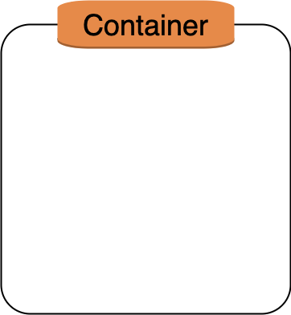
Namespaces
PID
MNT
NET

Slide 97

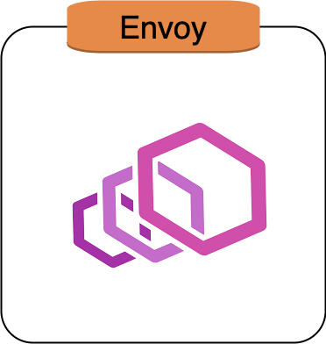
POD
NET

Slide 98
OS (Linux)
Namespaces
Control Groups (cgroups)
Union File System

Slide 99
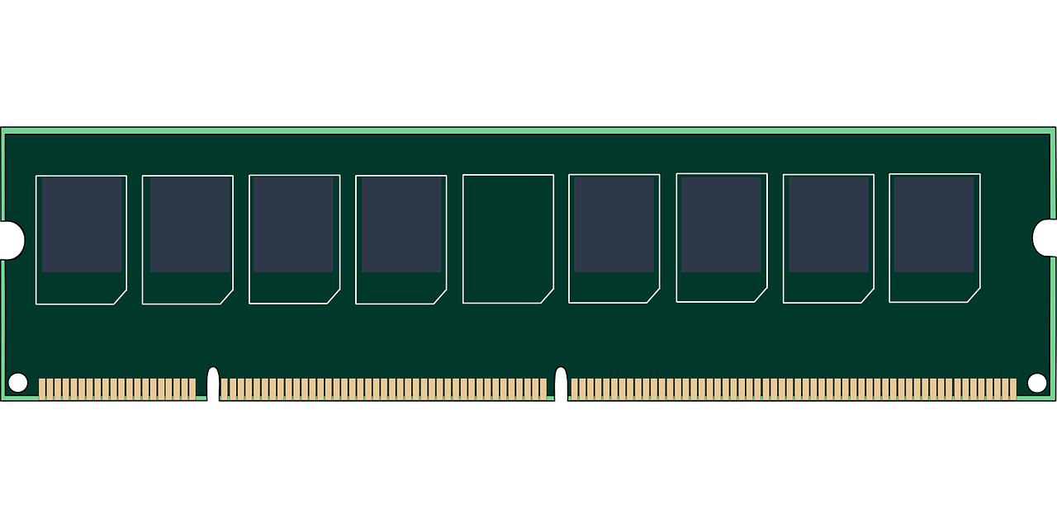

Control Groups (cgroups)
Parent 1
Parent 2
Child 2-1
Child 2-1
Child 2-1-1
Child 2-1-1
Parent 2
Parent 1

Slide 100
Control Groups (cgroups)
cgroups

Slide 101
OS (Linux)
Namespaces
Control Groups (cgroups)
Union File System

Slide 102

Union File System
Layer 2
Layer 1
scratch

Slide 103

Union File System
Container layer
Layer 2
Layer 1
scratch

Slide 104
OUTLINE
Deploying an application on K8s
Under the hood from the following perspectives:
User
Cluster
Networking
Cloud
OS (Linux)
Container Essentials
Kubernetes Nodes

Slide 105
Node
kubelet
Kube api server
pod
Docker
Cult api
Infra 10.255.0.10
prometheus
Cult api
envoy
prometheus
envoy

Slide 106
Node
kubelet
CNI
Infra 10.255.0.10
Docker
Cult api
prometheus
envoy

Slide 107
Node
kubelet
CNI
Infra 10.255.0.10
rkt
Cult api
prometheus
envoy

Slide 108
Node
kubelet
Infra 10.255.0.10
rkt
CNI
Cult api
prometheus
envoy

Slide 109
Logging
Kube api server
kubelet
Docker
Pod

Slide 110
Logging
cloudwatch
fluentd
K8s metadata
Docker
Pod

Slide 111
Monitoring
Node exporter
Metrics server

Slide 112
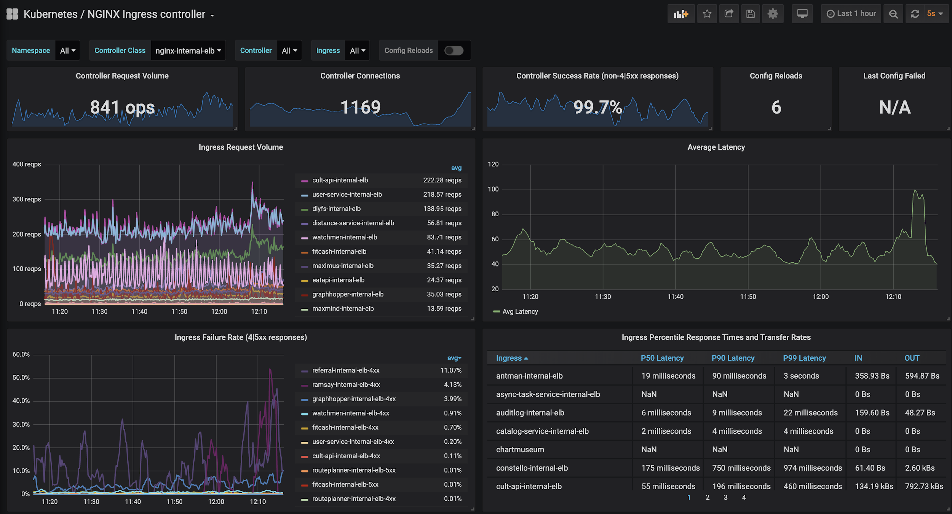
Monitoring

Slide 113
Power User
Security Context
Network Policies
Downward API
Config Maps/ Secrets

Slide 114
References
Kubernetes Deconstructed by Carson Anderson
Kubernetes Design Principles by Saad Ali
Scale Kubernetes Service Endpoints 100x - Minhan Xia & Wojciech Tyczynski, Google
http://k8s.io/

Slide 115
Blog
Revamping the Curefit Cloud: A Kubernetes Story

